Slide 1
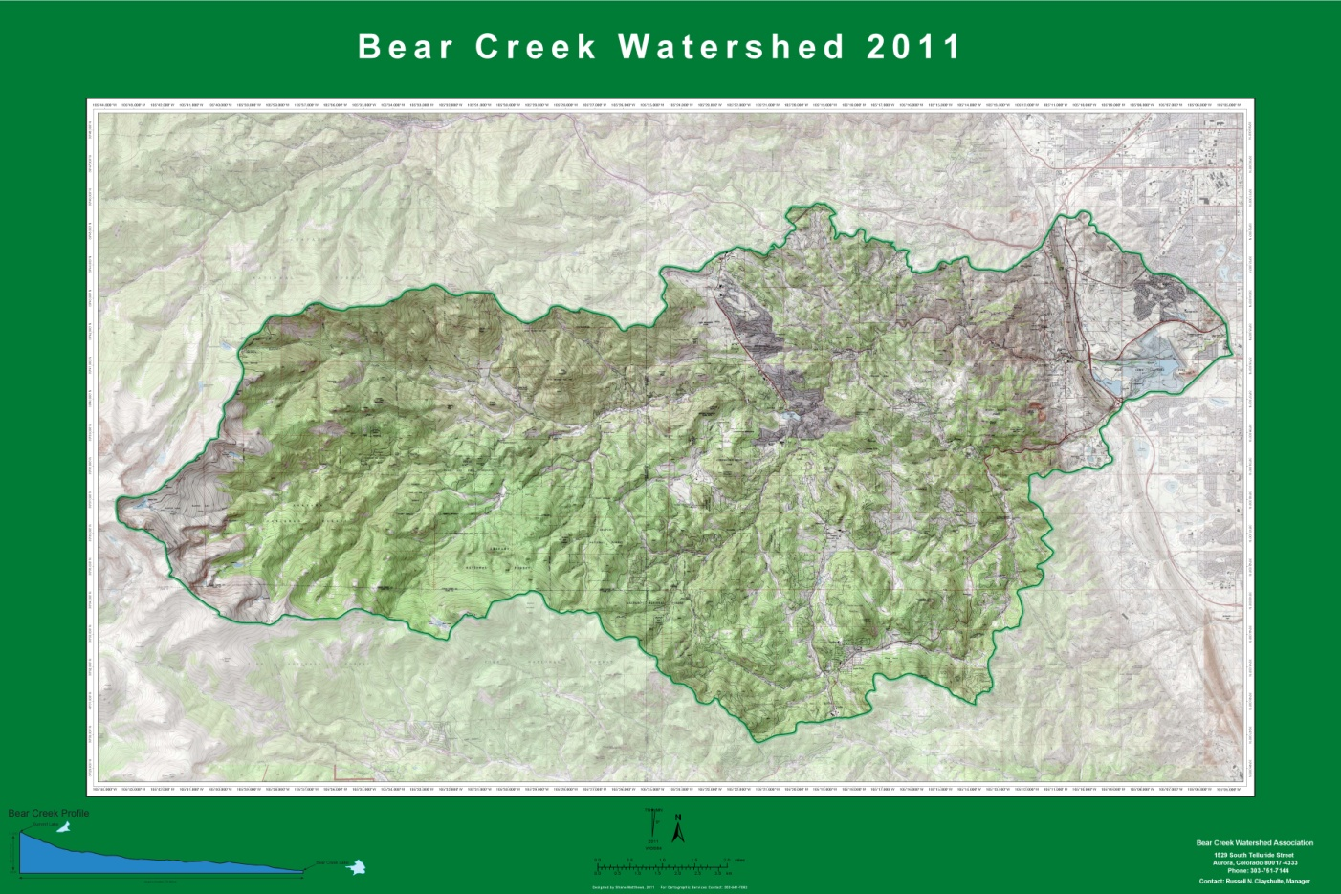
BCWA Watershed Boundary
Boundary in use by BCWA from 1998-2015

Slide 2
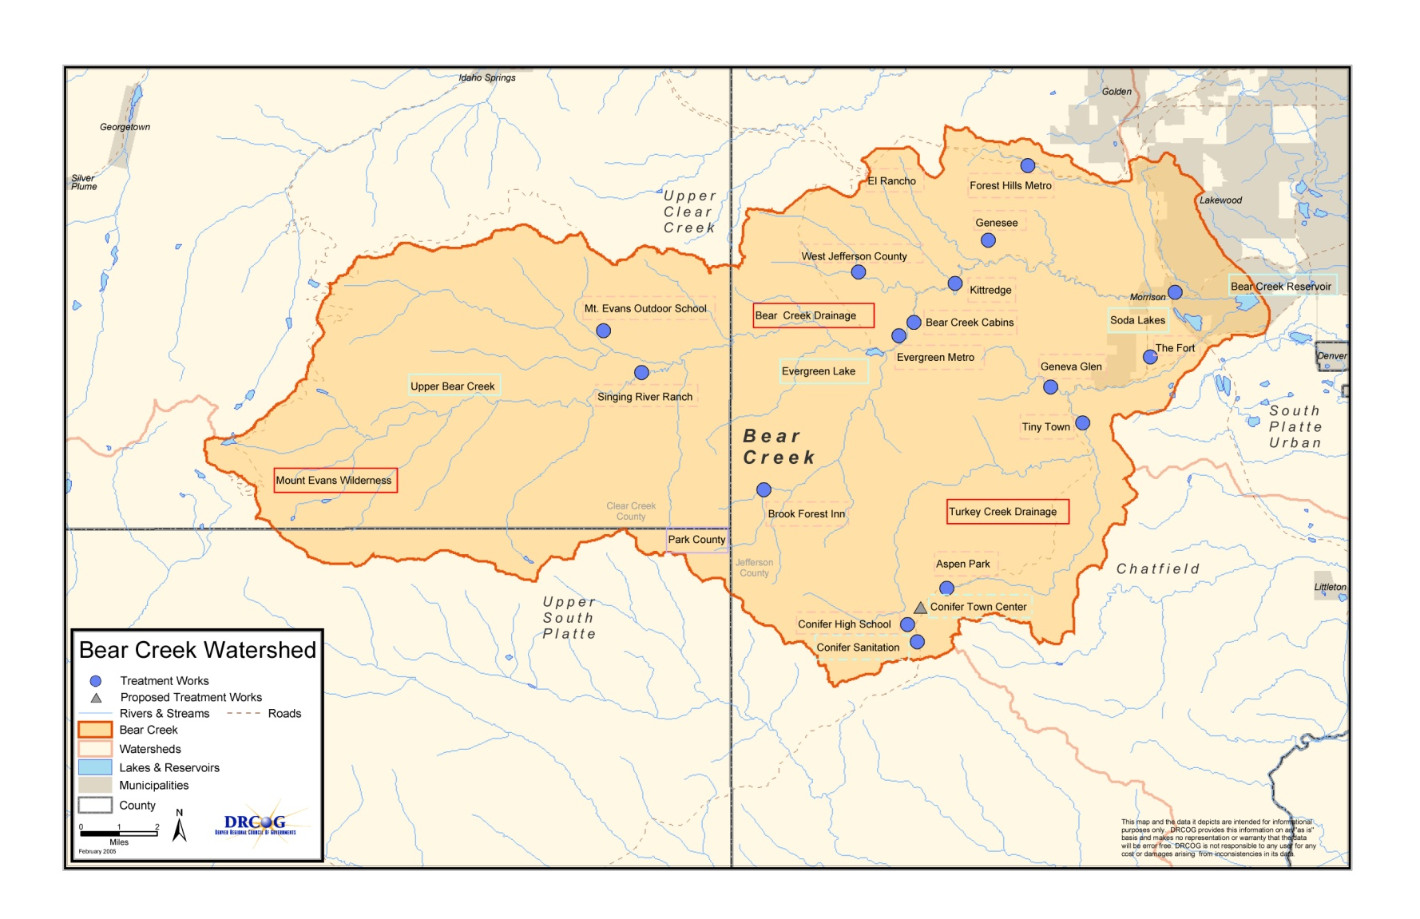
2005 DRCOG Revised Map
illustrative map for the adopted regulation on July 6, 1992

Slide 3
BCWA Policy 13 Watershed Boundary

Slide 4
In 2011
The lower watershed boundary ends where Bear Creek flows under South Kipling Parkway (west side of road).
The lower watershed includes portions of the developments on Green Mountain.
The watershed includes the Coyote Gulch drainage from the headwaters into Bear Creek Reservoir.

Slide 5
Sheridan Sampling
At one time the WQCD had the BCWA sample at Sheridan. Gaging station.
We have Fecal coliform and E. coli data for Sheridan site
Negotiated with state staff to drop this site and switched to upper watershed. WQCD wanted a Wadsworth site. All this was part of the 2005 Reg #74 pre-hearing discussions. The intent was to remove monitoring from regulation.

Slide 6
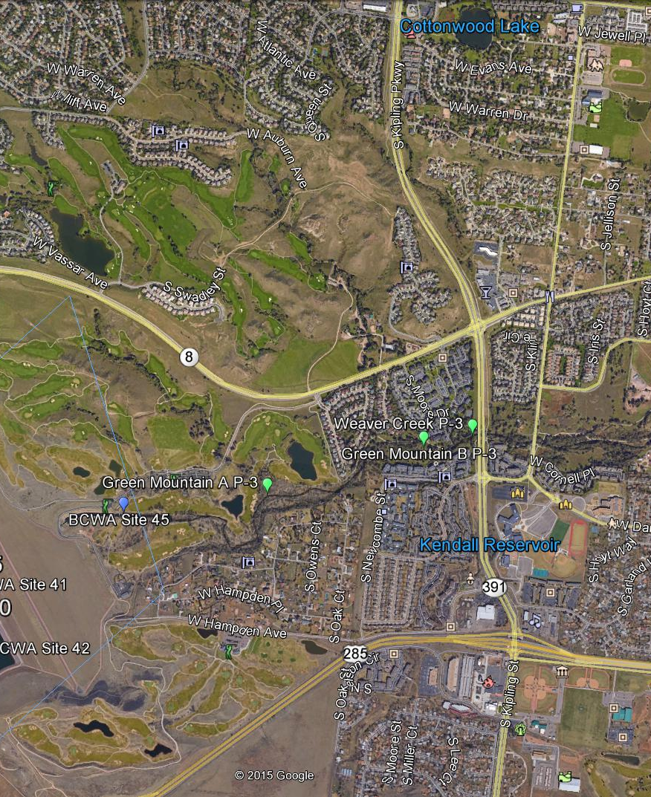
Lower bcw

Slide 7
303(d) listing Bear Creek Segment 2
Seg | Stream Segment Description | Portion | M&E | 303(d) Listing | Priority | Status
2 | Mainstem of Bear Creek from the outlet of Bear Creek Reservoir to the confluence with the South Platte River. | Below Kipling Parkway (CO 391) | Aquatic Life | E.coli (May-Oct), As, Aquatic Life (provisional) | H

Slide 8
Lower Bear Creek Boundary

Slide 9
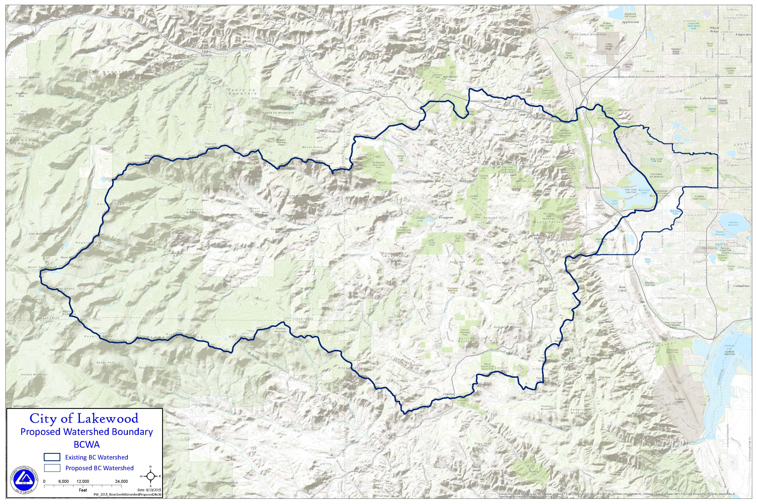
Proposed Lakewood

Slide 10
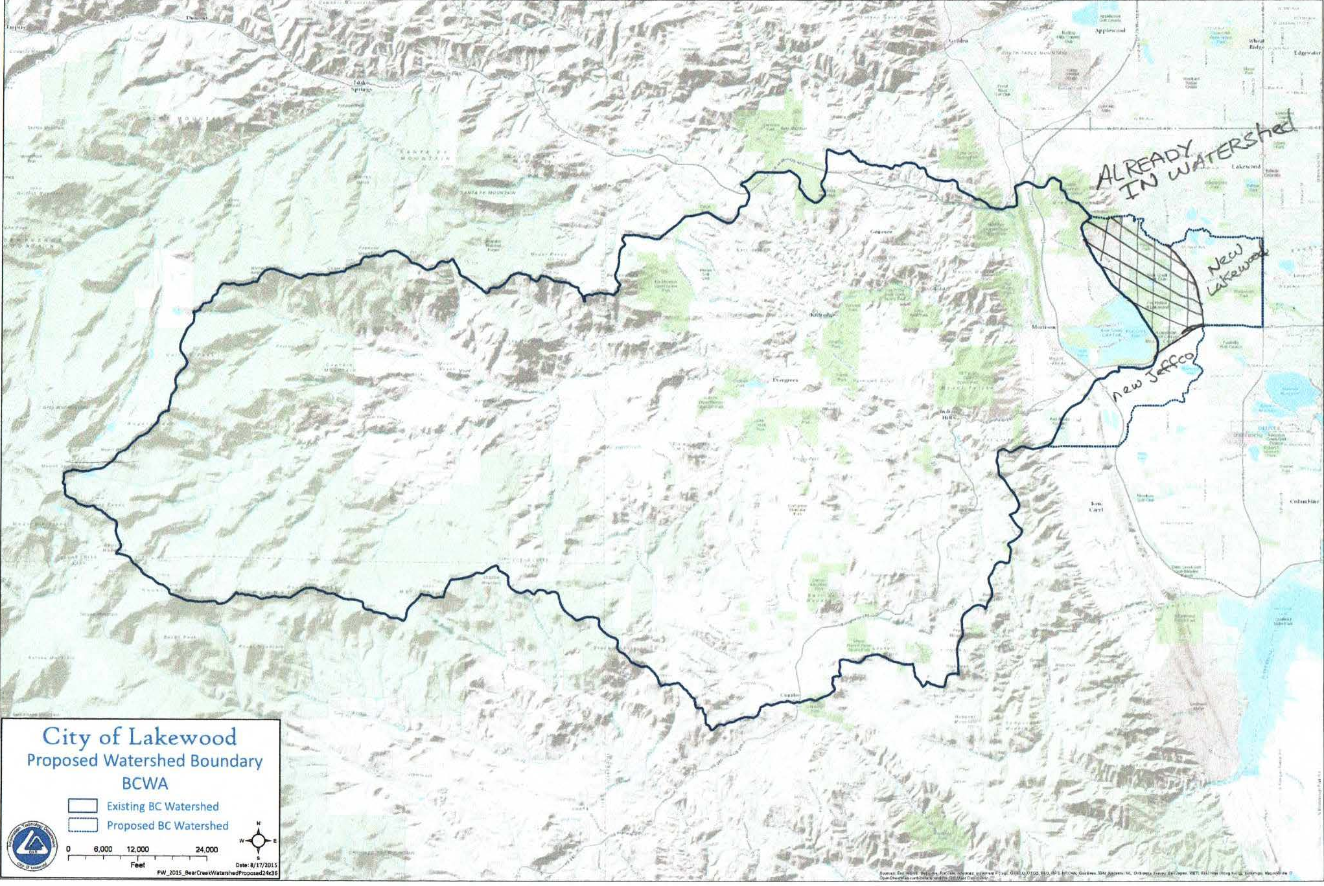
Corrected

Slide 11
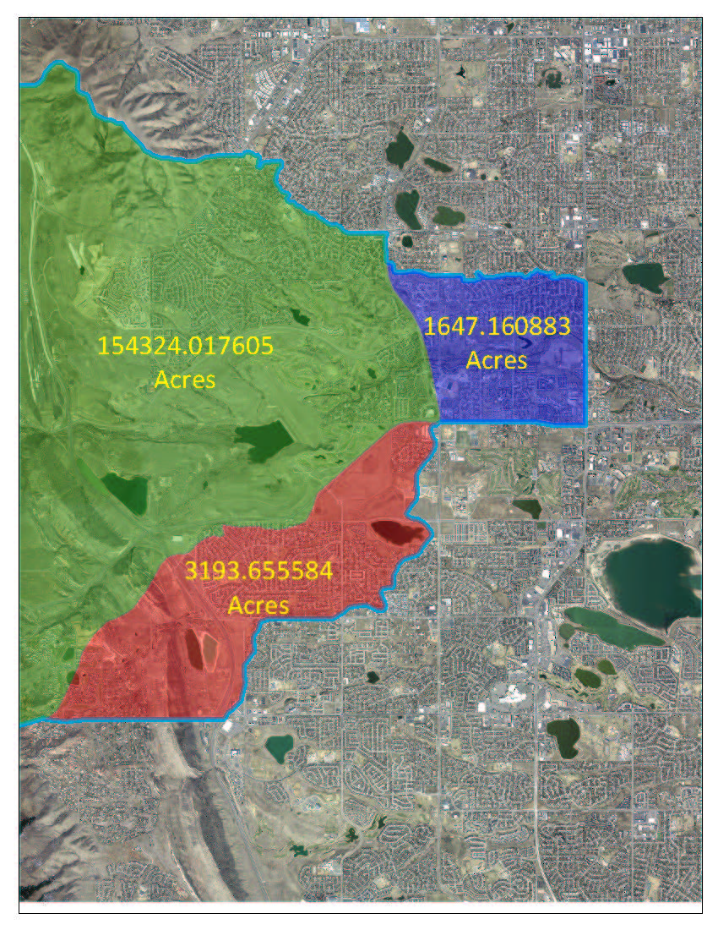
Added Area
Weaver Creek drainage was already discharging into Bear Creek at a point within the existing watershed boundary. The addition of Weaver Creek drainage is merely a hydrologic correction.

Slide 12
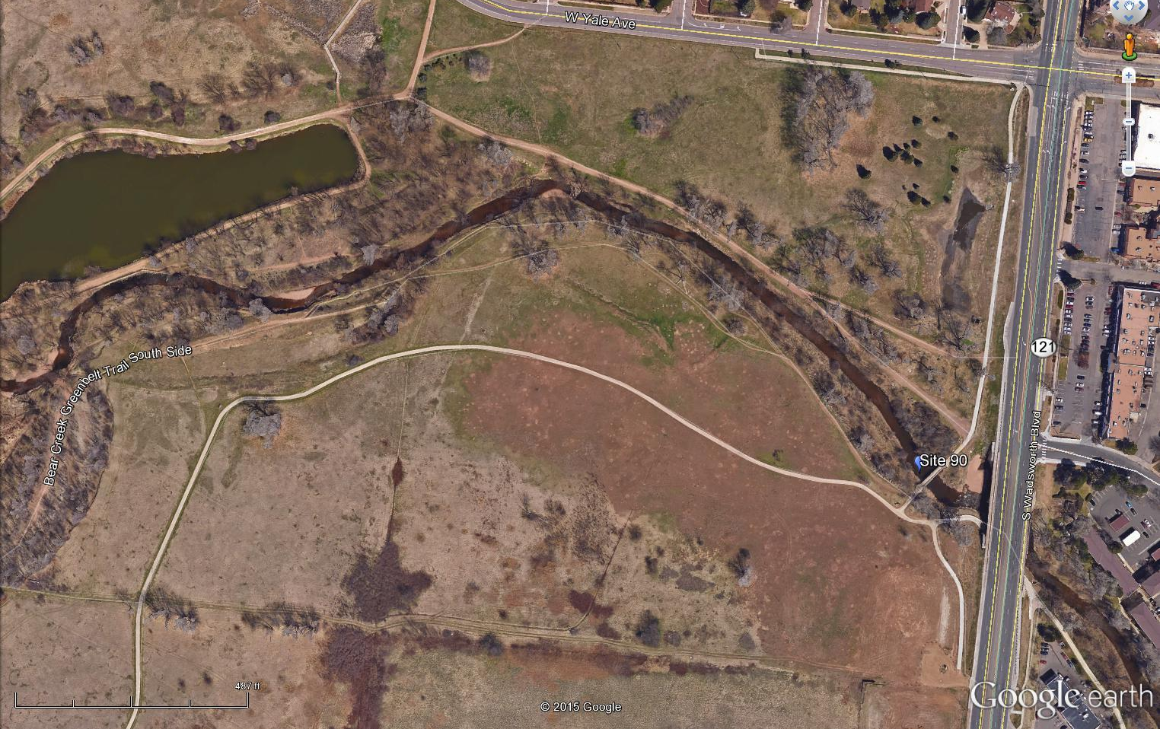
New P-1 Monitoring at Wadsworth

Slide 13
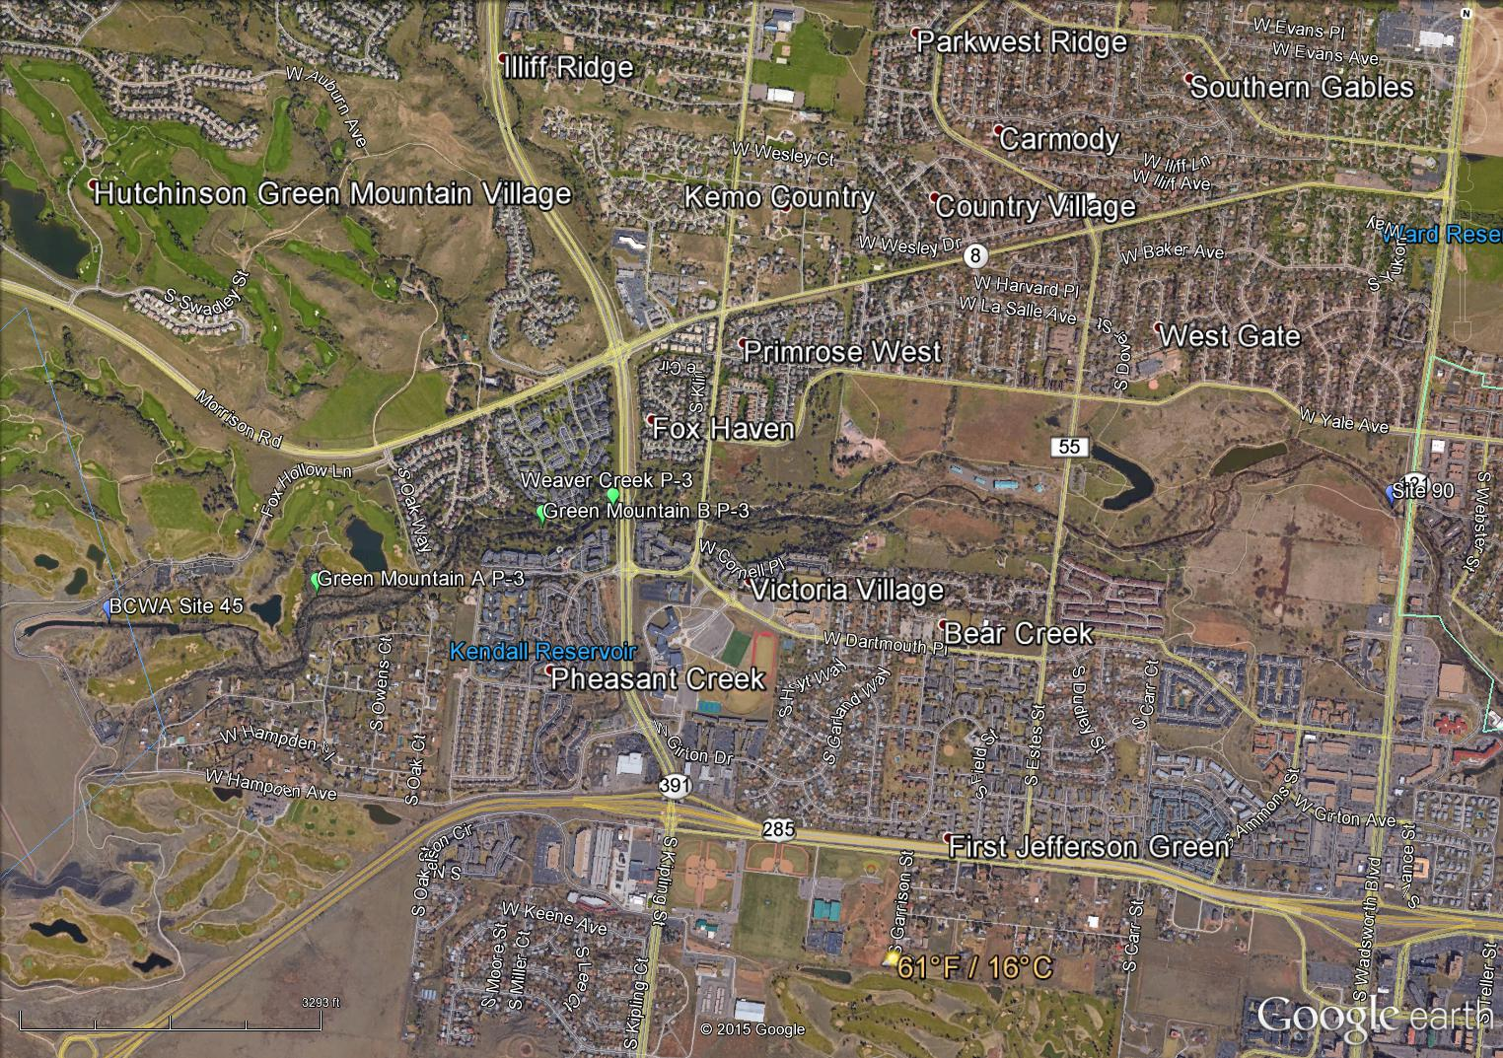
Secondary Potential Sites

Slide 14
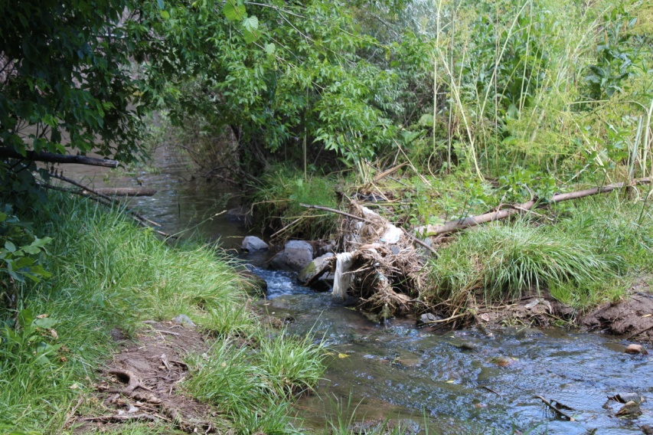
P-1 Monitoring
Parameter (units) | Site 90
Flow/ Discharge (cu m/s) | Manual
Specific Conductance (umhos/cm) | X
Dissolved Oxygen (mg/l) | X
Temperature (C) site visit | X
Temperature (C) data logger year round | X
Total Suspended Sediments (mg/l) | X
E. coli cts/100ml | X Monthly
pH (standard unit) | X
Nitrate + Nitrite Nitrogen (ug/l) | X
Total Nitrogen (ug/l) | X
Total Ammonia (ug/l) | X
Total Dissolved Phosphorus (ug/l) | X
Total Phosphorus (ug/l) | X
Weaver Creek Discharge into Bear Creek upstream of Kipling
Monitoring Site Survey
Macroinvertebrates | Habitat Indices
Periphyton Coverage | Physical Stream Indices
Pebble Counts | Water Clarity - Staining
Flow | Embeddedness

Slide 15
Merits of a Boundary Correction
Clarify Lower Bear Creek boundary overlaps with BCW
Use Wadsworth so Lakewood completely within BCW, Clarifies Lakewood involvement
Weaver Creek hydrologic correction
Green Mountain hydrology acknowledgment besides Coyote Gulch
Better able to address E. coli concern for area

Slide 16
And More
Inclusion of potential new revenue sources that off-set recent losses
Use Wadsworth water quality data as input for Barr-Milton models, rather than site 45 reservoir discharge
Improve cooperation with LBC group
New monitoring costs minimal and covered by Lakewood and potentially new districts

Slide 17
Plus
There are at least 4 others monitoring in BCW lower area, reduce conflicts
Demonstrate to state we are an effective management agency and can problem solve
Prevent adoption of an E. coli TMDL for a portion of BCW that is not necessary, which could include BCR
Negatives for current membership, not really

