Slide 1
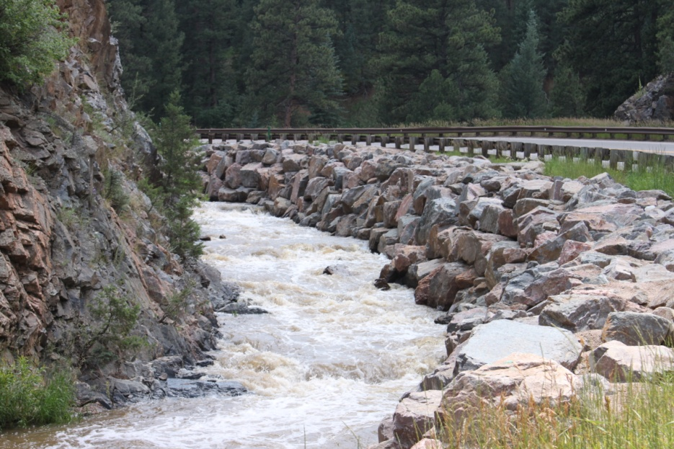
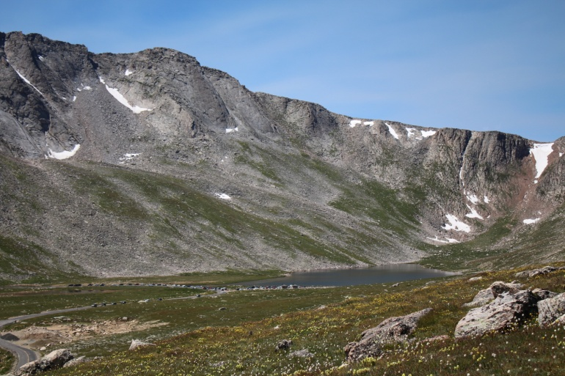
Bear Creek Watershed Association
The Bear Creek Watershed Association protects & restores water & environmental quality within the Bear Creek Watershed from the effects of land use.
Bear Creek Association Newsletter
BCWA PINNACLE
2014-2015 Flood Recovery

Slide 2
2014 Estimates of Recreation Use Bear Creek Watershed
Recreational Users Bear Creek Park > 580,000
People Traveling to Mt. Evans > 177,000
Mt. Evans Wilderness lower access > 25,000
Users Denver Mountain Parks > 225,000
Jefferson County Open Space > 80,000
Users Evergreen Lake > 275,000
Attendees & Visitors Red Rocks/Morrison >1.3 million
Bear Creek Park Swim Beach Use > 750 per weekend
Fishing > 65,000 people per year
BCWA Fact Sheet 35 Recreational Uses in BCW >50
Fact Sheet 36 Larger Mammals
Fact Sheet 12 Fish Species
Fact Sheet 37 Smaller Mammals
BCW Total Species
Common Sport Fish | Other Report Fish
16 | 14

Slide 3
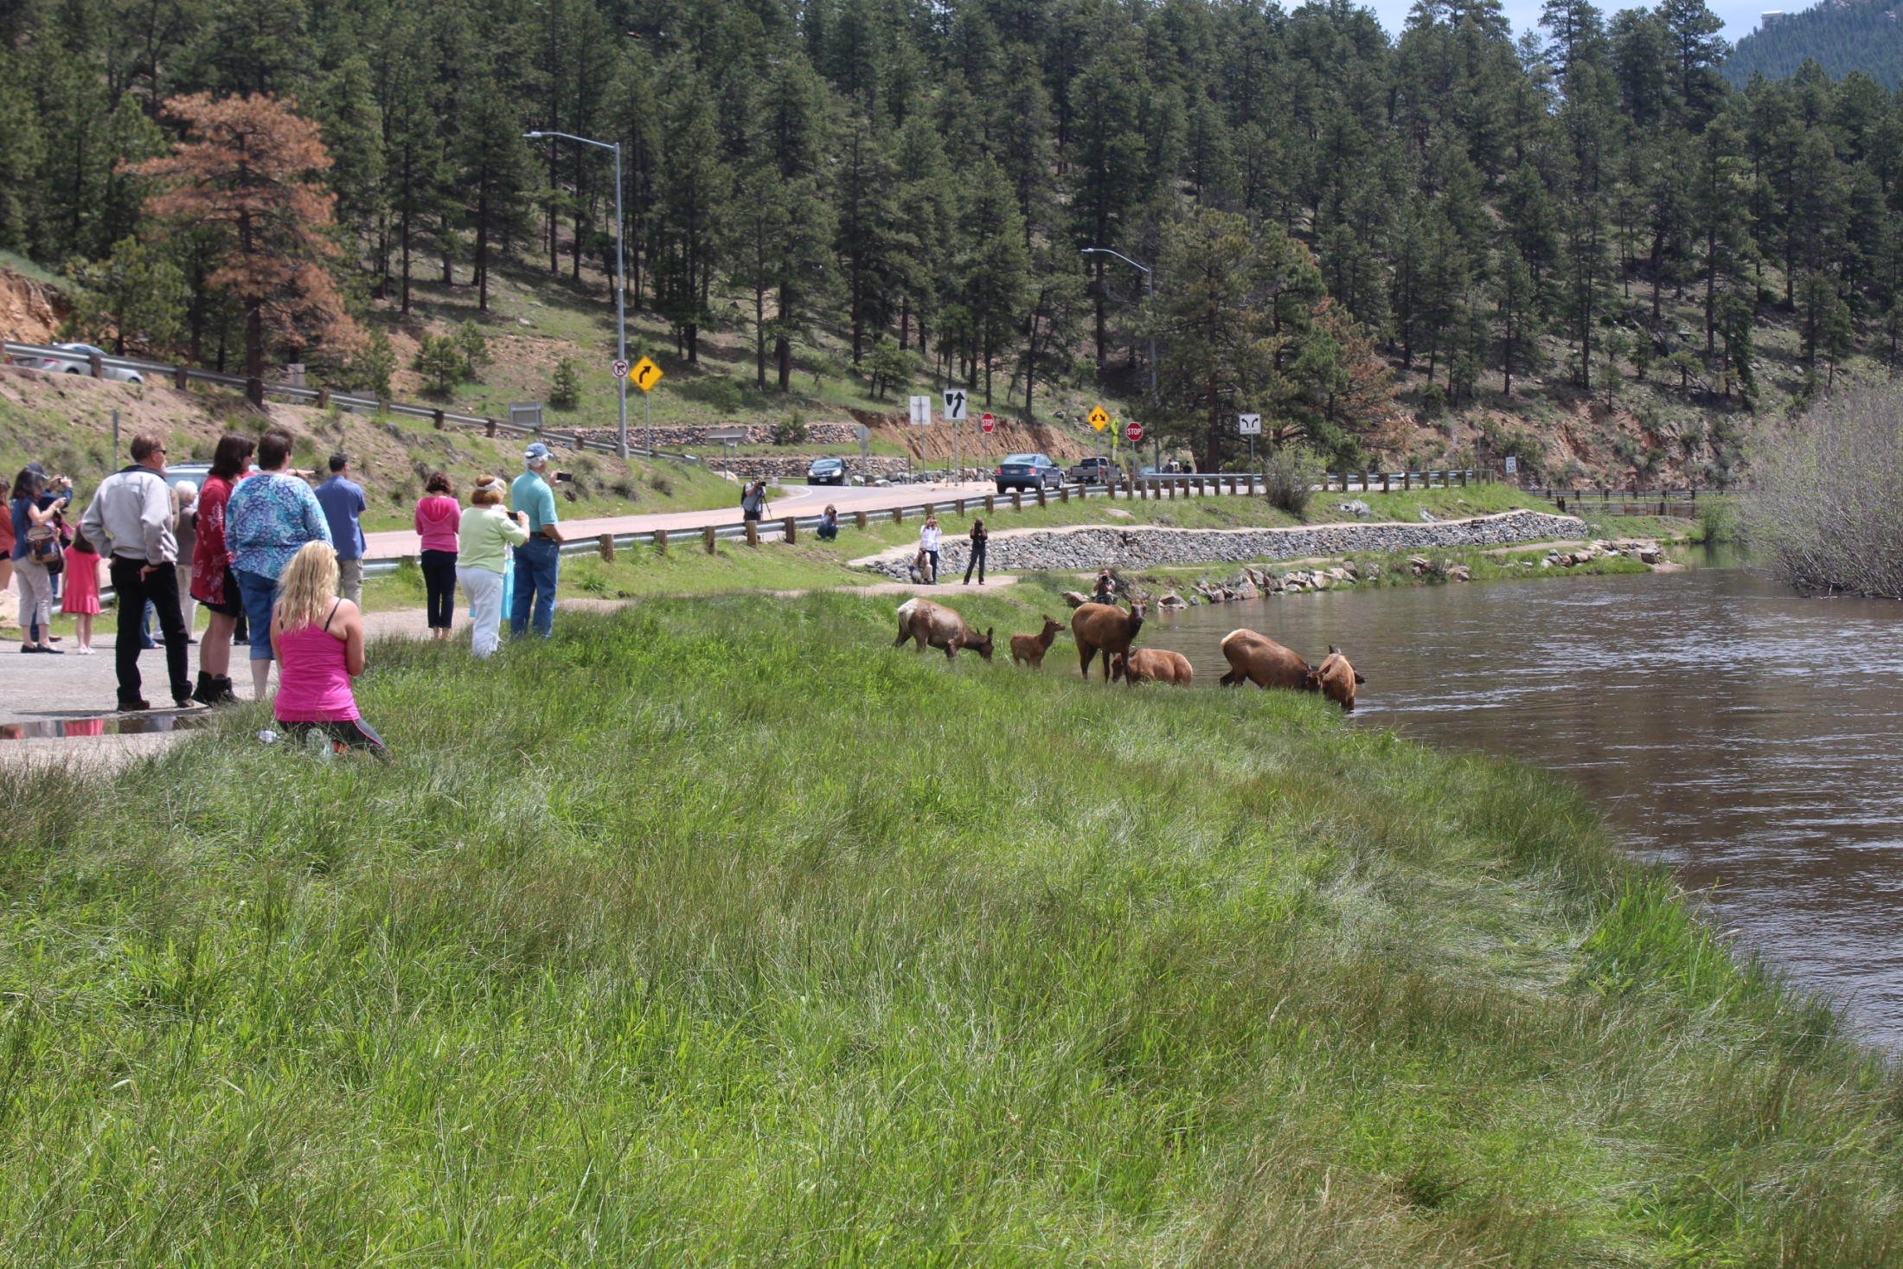

Slide 4
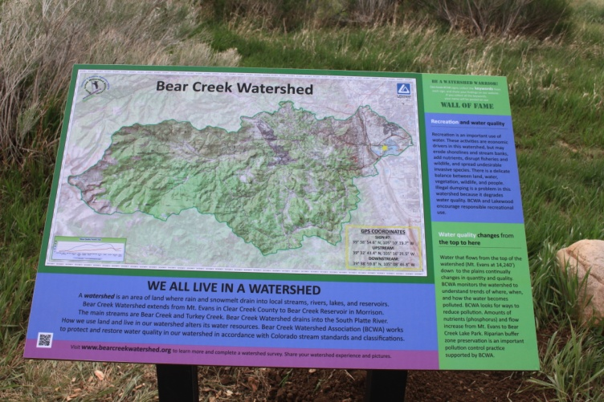
Members & Participants | Wastewater Discharger | 2014 Participation
Counties
Jefferson County |  | Active
Clear Creek County |  | Active
City and Towns
City of Lakewood |  | Active
Town of Morrison | Yes | Active
Water & Sanitation Districts
Aspen Park Metropolitan District | Yes | Active
Bear Creek Cabins | Yes | Active
Brook Forest Inn | Yes | Active
Conifer Sanitation Association | Yes | Dues Paid, Not Active
Conifer Metropolitan District | Yes | Dues Paid, Not Active
Evergreen Metropolitan District | Yes | Active
Forrest Hills Metropolitan District | Yes | Active
Genesee Water & Sanitation District | Yes | Active
Geneva Glen | Yes | Dues Paid, Not Active
Jefferson County School District | Yes | Active
Kittredge Water & Sanitation District | Yes | Active
Singing River Ranch | Yes | Dues Not Paid, Not Active
The Fort Restaurant | Yes | Active
Tiny Town Foundation, Inc. | Yes | Dues Paid, Not Active
West Jefferson County Metropolitan District | Yes | Active
Other Member
Denver Water Department |  | Active
Participant Agencies
Denver Health/ Parks & Recreation |  | Attended
Evergreen Trout Unlimited |  | Active
U.S. Army Corps of Engineers |  | Attended
WQCD |  | Attended

Slide 5
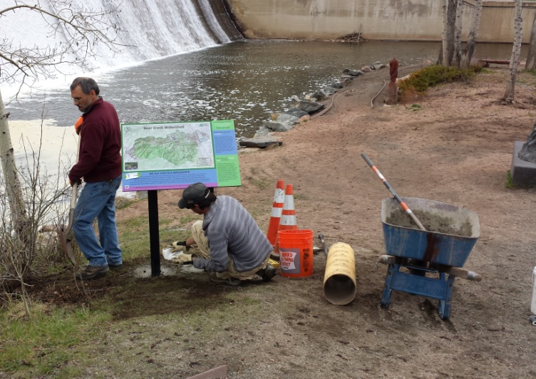
BCWA 2015 Watershed Plan
Online Decision Support Program
Electronic Watershed Plan (10.8 GB)
35 Policies
51 Fact Sheets
18 Data Masters
34 Informational Maps
20-yrs of Rulemaking & Standards
21 Program Documents
>75 linked reports & documents
18 Wastewater Management Summaries
+ Other Informational, Methods, Program Guidance, Technical Series, Special Studies, Annual Monitoring Plans
Photo Library (>18 GB)
Quarterly Newsletter (>300)
Increased NPS education
Membership special programs

Slide 6
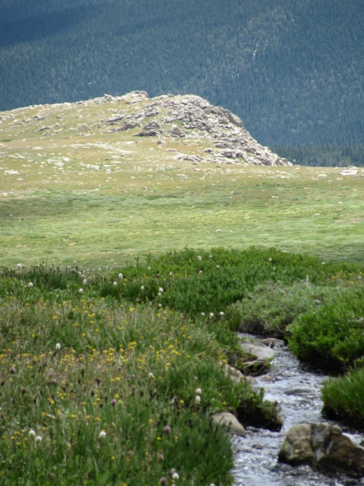
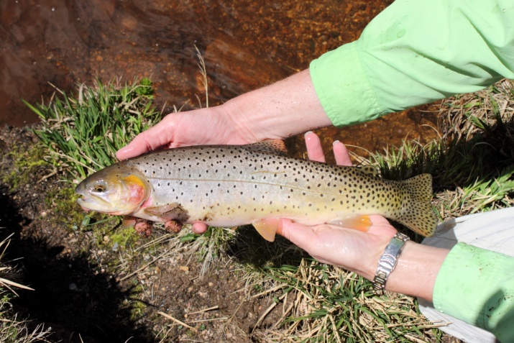
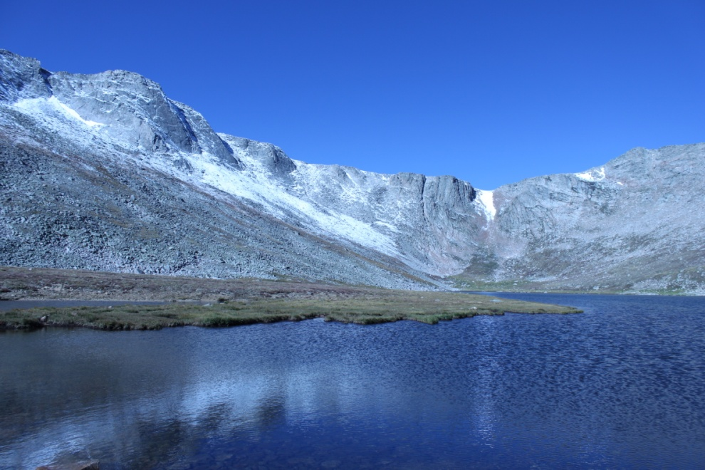
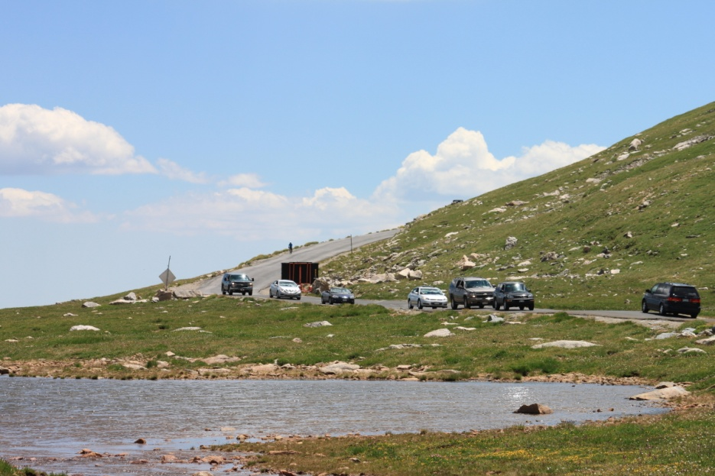
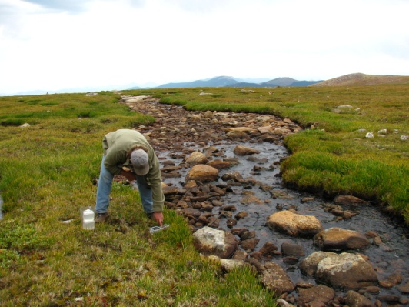
Sampling Begins at the Top

Slide 7
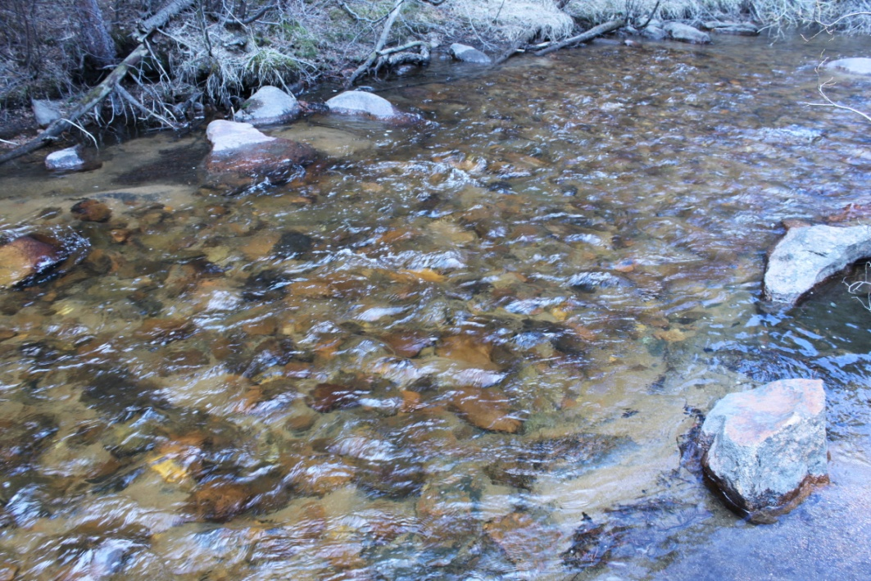
Monitoring Program Elements
Water quality monitoring program
87 Sites (some monitored since 1991)
5 Bear Creek Reservoir monitoring profiles
Evergreen Lake profiles
Physical, Chemistry & Biology
Year round temperature monitoring of Bear Creek and Turkey Creek
>2,750,000 measurements
Monitor total phosphorus, dissolved phosphorus, nitrate+nitrite, total ammonia, total nitrogen, TIN, oxygen, specific conductance, temp, carbon, pH, bacteria, phytoplankton, zooplankton, chlorophyll, Secchi, TSS
Special Studies
Fishery surveys at 12 sites
Macroinvertebrate collections
Habitat
Flow studies
BMP Effectiveness
Stormwater data collection
E. Coli
Septic Systems Contributions
Lake Sediments

Slide 8
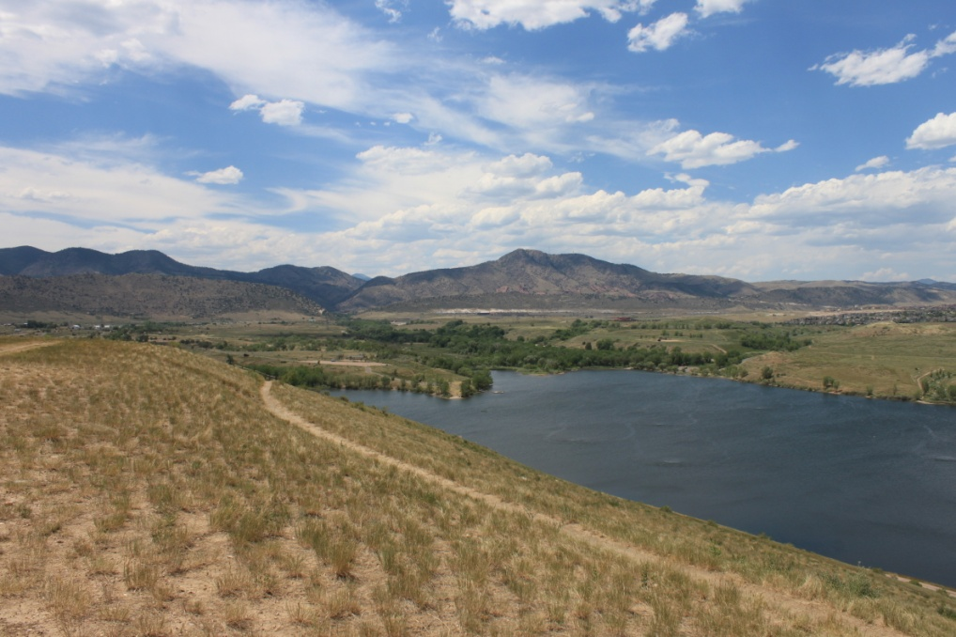
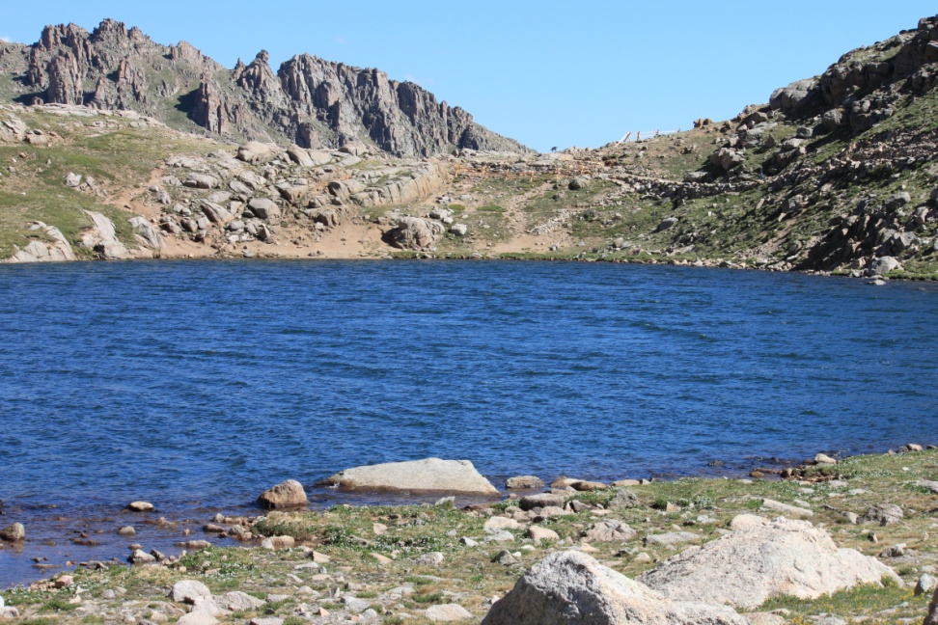
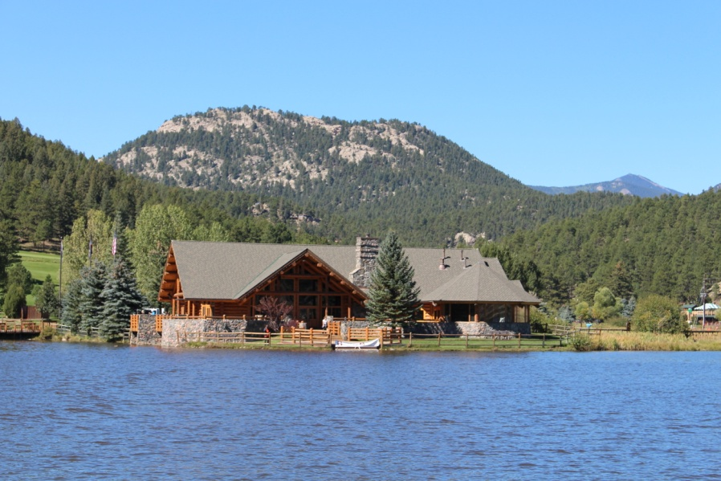
Reservoir/ Lake Studies
Bear Creek Reservoir
Inflow Turkey Creek
Inflow Bear Creek
Outflow site 45 (input Barr/Milton Watershed
Evergreen Lake
Summit Lake
Water Supply Reservoirs

Slide 9
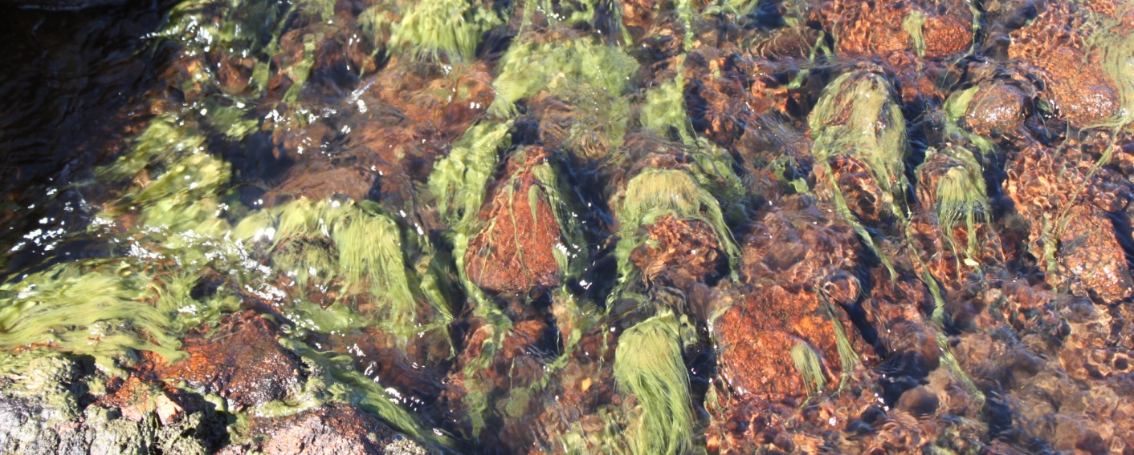
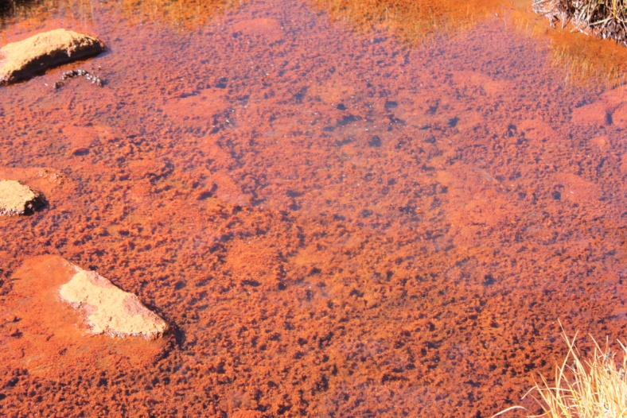
Summit Lake & Upper Bear Creek
Data demonstrates pollution source(s) causing elevated nutrient loads (>75 years), low pH conditions and reduced dissolved oxygen
Repaired new toilet vaults
Plume diminishing
Reduced Total Phosphorus 2014 avg 216 ug/l
Peaked >4.1 mg/l (>129 pounds per season)
Reduced Total Nitrogen 2014 avg 377 ug/l
Peaked > 3.1 mg/l (>118 pounds per season)

Slide 10
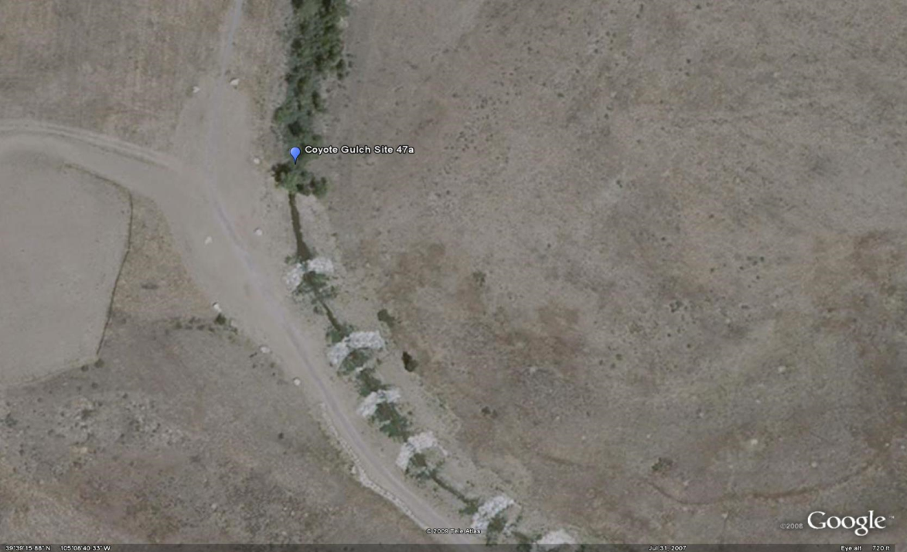
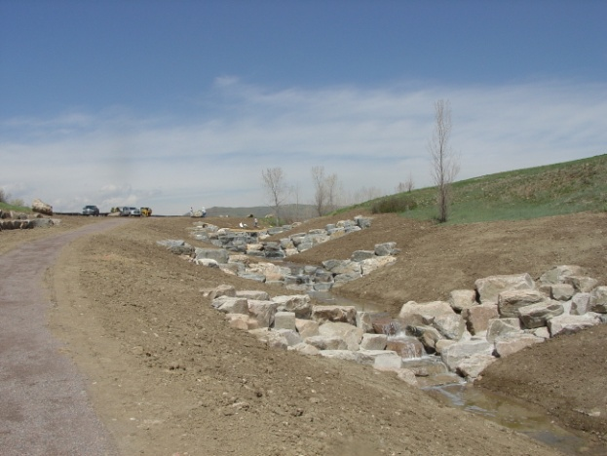
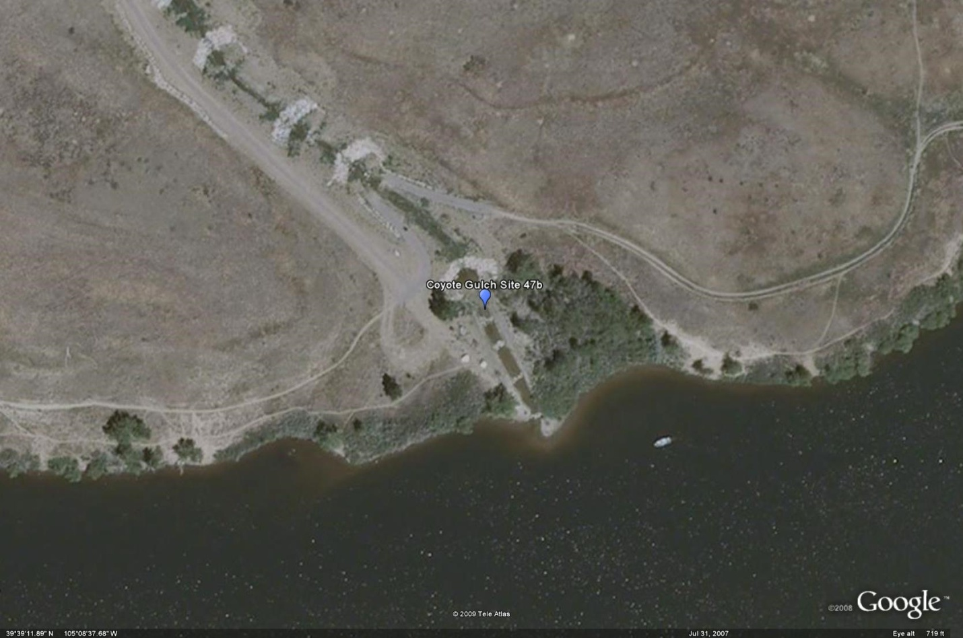
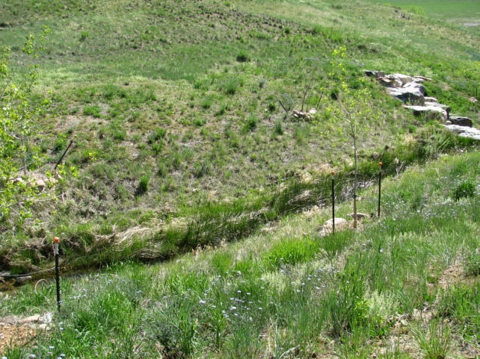
Coyote Gulch
2006-2015
Trade Pounds = 92.2

Slide 11
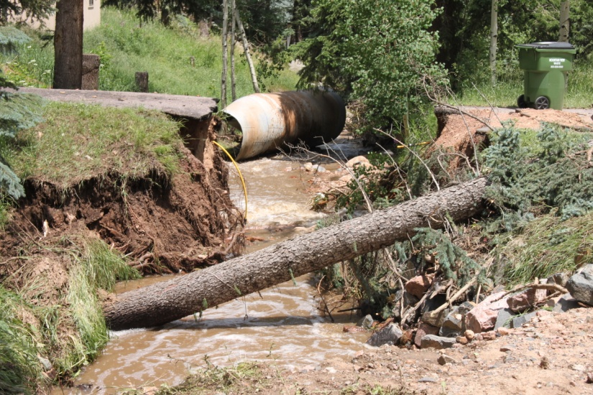
Adaptive Management Program
Nonpoint source loading & tracking
Coyote Gulch - Trading
Septic Systems – Kerr & Cub
Tracking management practices
Zoning and planning reviews for BMPs
Local presentations, education programs
Flood restoration practices,
Assist land-owners
Assist invasive species programs
Green Infrastructure projects
Wildfire assessment
Source water protection
Tributary loading studies
Erosion Control Reviews
Online adaptive management

Slide 12
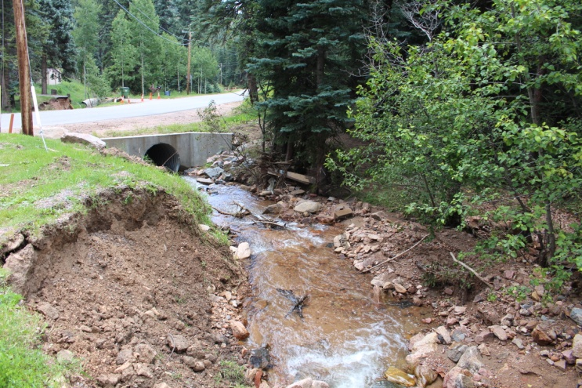
Annual Report
WQCC Summary
Status of Water Quality (Flood Recovery)
Status of WQ Goals & Standards (Temperature)
Phosphorus Trading Program (3 trade policies)
Bear Creek Watershed Association Program

Slide 13
TN Data

Slide 14
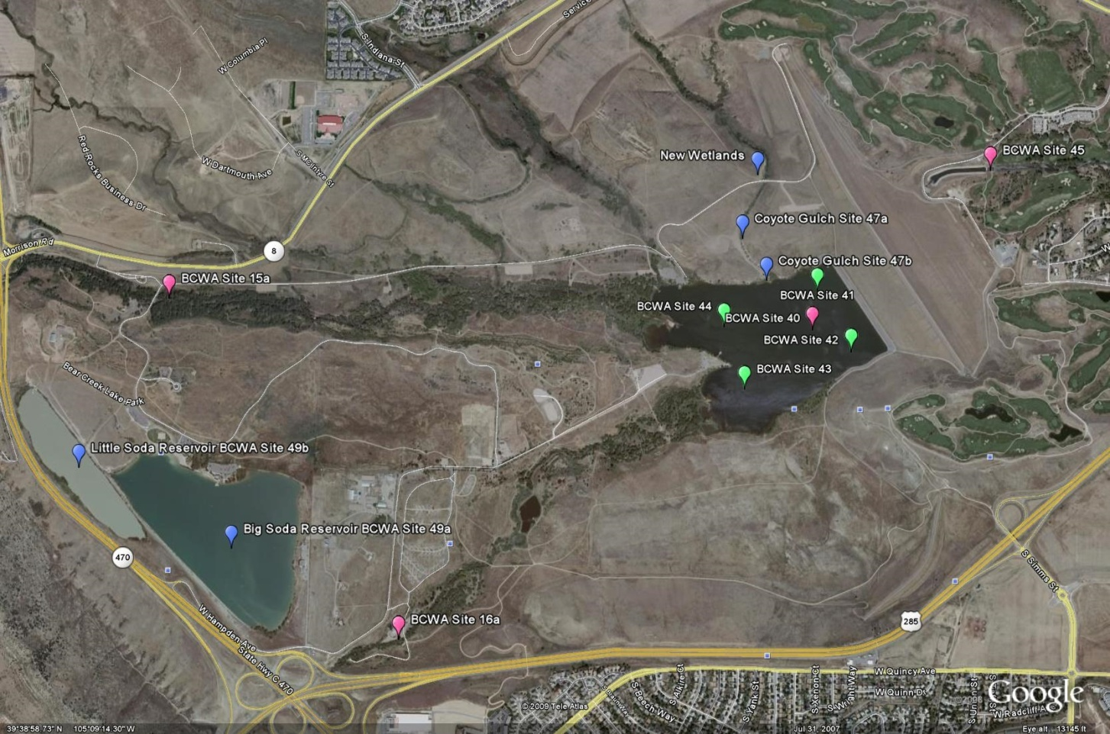
Bear Creek Reservoir & Park

Slide 15
2014 BCR Internal Load Problem

Slide 16
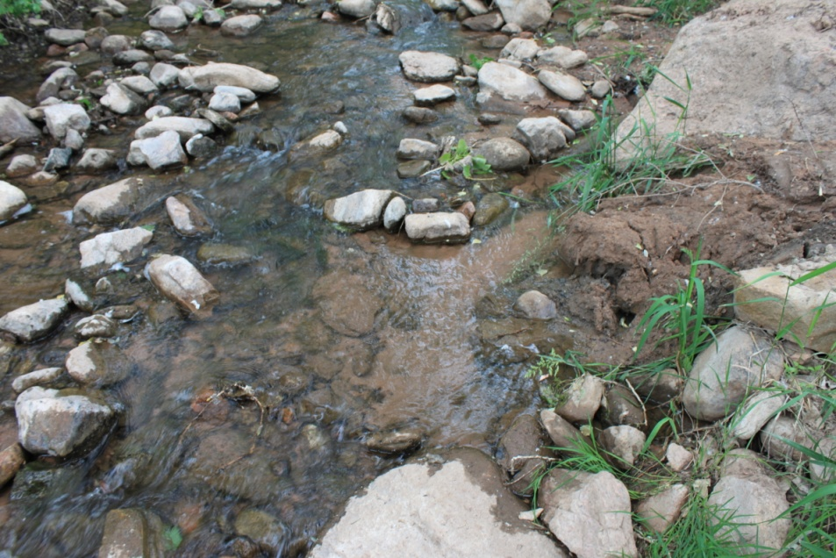
Total Phosphorus Loading
2014 Total Phosphorus Loading (Pounds)
 | Total TP Load | PS | NPS | %NPS
Turkey Creek Drainage | 489 | 7 | 482 | 99%
Bear Creek Drainage | 3,521 | 1,069 | 2,452 | 56%
Discharged into Reservoir | 4,010 | 1,076 | 2,934 | 63%
Site 45 Outflow BCR | 1,980
BCR Total Phosphorus Deposition | 2,031

Slide 18
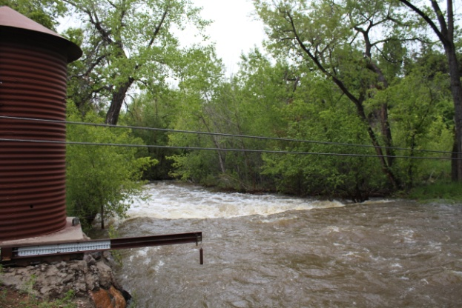
Watershed Hydrology
In the last 115 years, only 2 years with similar flow 1901 & 1944

Slide 19
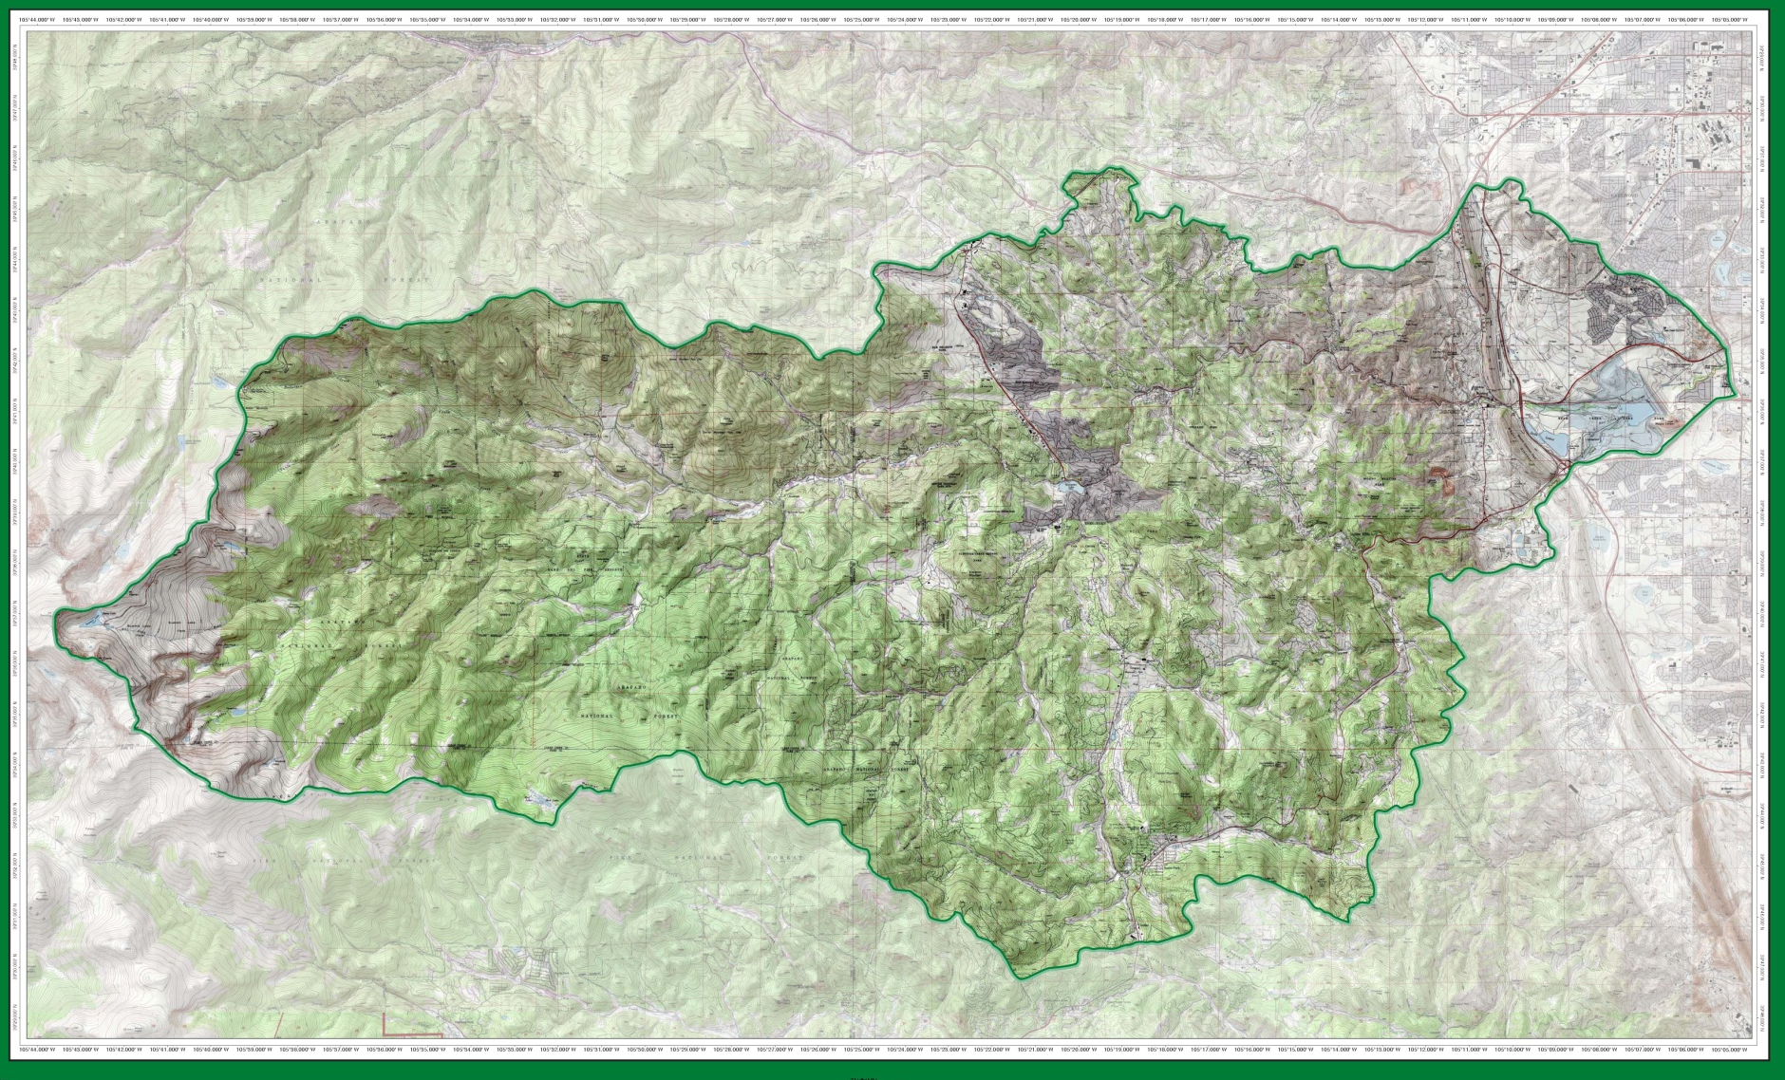
Bear Creek Watershed 2015

Slide 20
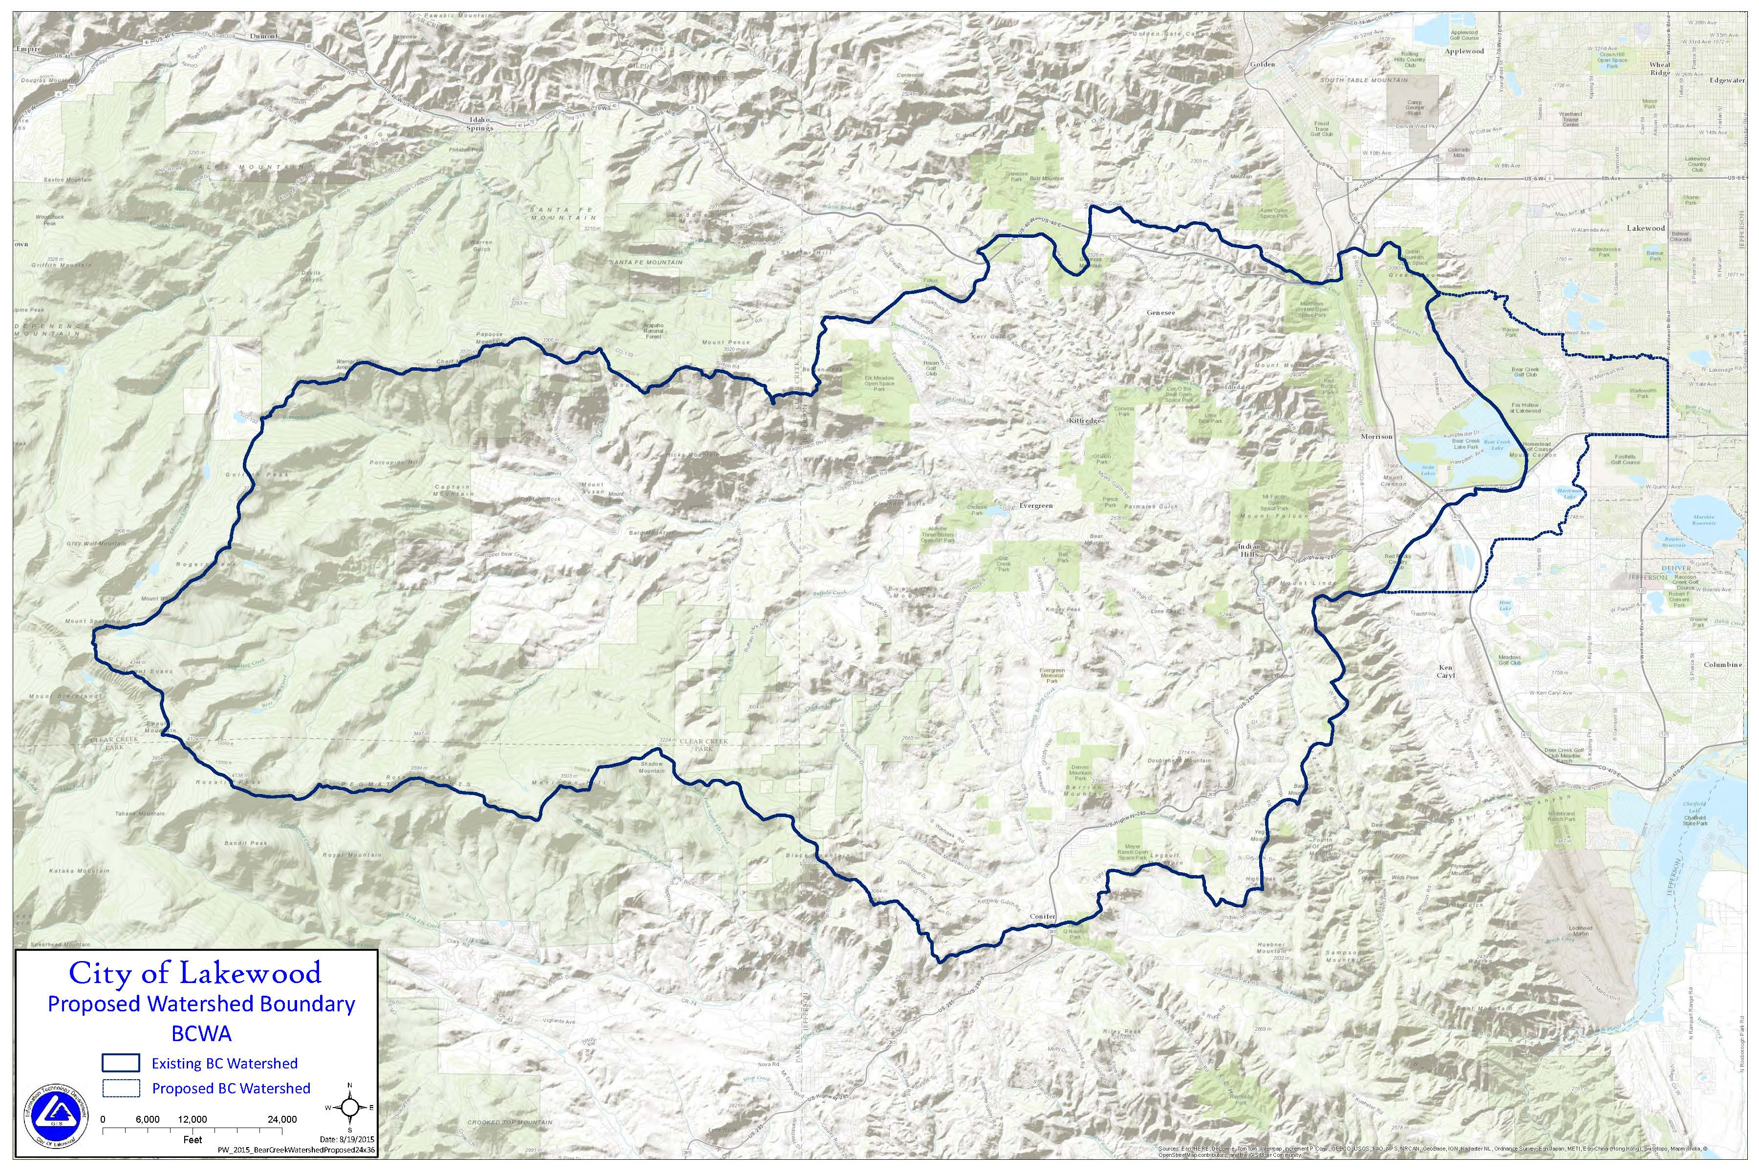
BCW 2016

Slide 21
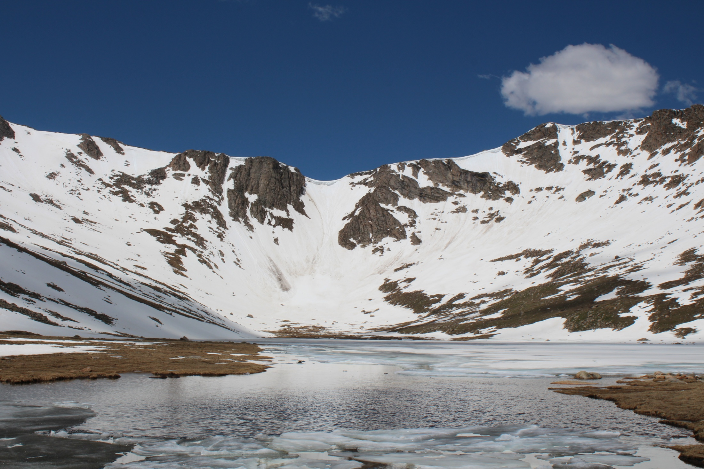

Slide 22
